Slide 1
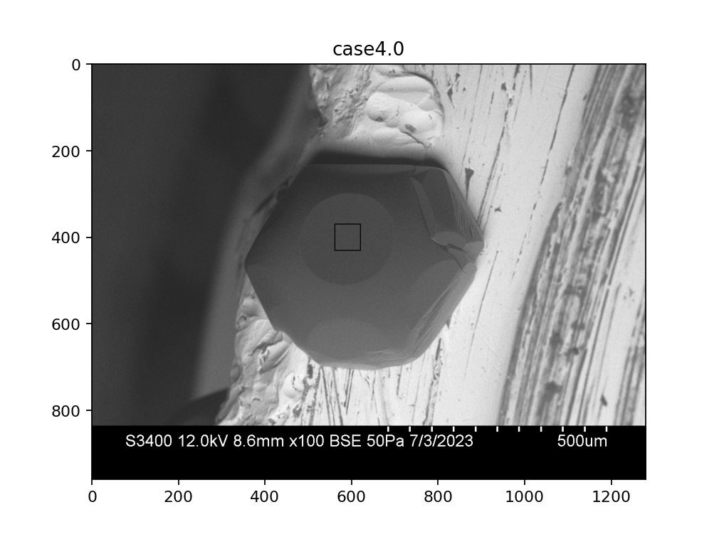
D
B-detector image
A
C
B

